Slide 1
Chip Design
cpu, gpu, vpu
Linear Algebra

Slide 2
Types of Chip Design
1. Digital Design
Focus: Logic circuits, processors, memory, controllers.
Tools: Hardware Description Languages (HDLs) like Verilog, VHDL.
Example: CPUs, GPUs, FPGAs.
2. Analog Design
Focus: Continuous signals, amplifiers, sensors, RF circuits.
Challenges: Noise, precision, power efficiency.
Example: Audio chips, radio transceivers.

Slide 3
Types of Chip Design
3. Mixed-Signal Design
Combines digital + analog on the same chip.
Example: ADCs (Analog-to-Digital Converters), DACs, system-on-chip (SoC).
4. RF (Radio Frequency) Design
Specialized for wireless communication.
Example: Wi-Fi chips, Bluetooth modules, 5G baseband processors.
5. Memory Design
Focus: Storage elements (RAM, ROM, Flash).
Optimized for density, speed, and reliability.

Slide 4
Types of Chip Design
6. ASIC (Application-Specific Integrated Circuit) Design
Custom chips for a specific task.
Example: Bitcoin mining chips, AI accelerators.
7. SoC (System-on-Chip) Design
Integrates CPU, GPU, memory, and peripherals on one chip.
Example: Smartphone processors (Qualcomm Snapdragon, Apple A-series).
8. FPGA Design
Field-Programmable Gate Arrays: reconfigurable chips.
Used for prototyping, research, and specialized applications.

Slide 5
Design Flow Stages
Design Flow Stages
Specification → Architecture → RTL coding → Verification → Physical design → Fabrication → Testing.
Each type of chip design emphasizes different parts of this flow (e.g., analog design spends more time on simulation and layout, digital design on logic verification).

Slide 6
CPU,GPU, VPU
Processor | Full Form | Main Role | Example Use
CPU | Central Processing Unit | General-purpose computing, logic, control | Running operating systems, apps, calculations
GPU | Graphics Processing Unit | Parallel processing, graphics rendering, AI acceleration | Gaming, 3D rendering, machine learning
VPU | Vision Processing Unit | Specialized for image and video processing, computer vision | Object detection, facial recognition, autonomous driving

Slide 7
What is a VPU?
A VPU is designed specifically for computer vision tasks.
It handles workloads like image recognition, depth sensing, and video analytics more efficiently than CPUs or GPUs.
Examples: Intel’s Movidius Myriad VPU, Google’s Edge TPU (similar concept).
Used in drones, smart cameras, AR/VR devices, and autonomous vehicles.
📌 Key Difference
CPU = versatile, can do everything but not specialized.
GPU = excels at parallel math (graphics, AI).
VPU = optimized for vision and perception tasks, often with lower power consumption.

Slide 8
VPU
VPUs exist — they’re part of the new wave of domain-specific processors alongside NPUs (Neural Processing Units) and TPUs (Tensor Processing Units).
👉 Since you’re watching linear algebra videos right now, it’s worth noting: matrix operations (linear algebra) are the backbone of GPU and VPU workloads. Would you like me to show you how linear algebra directly powers image recognition in VPUs?

Slide 9
Role of VPUs in Autonomous Vehicles
Computer Vision Tasks: VPUs are optimized for image and video processing. In cars, they handle real‑time tasks like:
Lane detection
Traffic sign recognition
Pedestrian and cyclist detection
Object classification (cars, trucks, obstacles)
Efficiency: VPUs consume less power than GPUs while still delivering high throughput for vision workloads. This is important in cars where energy efficiency matters.
Integration: VPUs are often paired with CPUs and GPUs in heterogeneous computing systems inside autonomous vehicles.
CPU: General control logic, decision making.
GPU: Heavy parallel math (AI models, sensor fusion).
VPU: Specialized vision inference, especially for camera feeds.

Slide 10
Examples in Automotive Use
Intel Movidius Myriad VPU has been used in drones and automotive vision systems.
Mobileye (owned by Intel) integrates vision processors for advanced driver‑assistance systems (ADAS) and autonomous driving.
VPUs help process multiple camera streams simultaneously — critical for 360° awareness in cars.
⚖️ Why Not Just GPU?
GPUs are powerful but power‑hungry.
VPUs are lighter, more efficient, and specialized for vision, making them ideal for embedded automotive systems where thermal and energy constraints exist.
So yes, VPUs are a key part of autonomous car software, working alongside CPUs and GPUs to deliver safe, real‑time perception.

Slide 11
Matrix operations (linear algebra) form the mathematical backbone of what VPUs (Vision Processing Units) do in autonomous car systems:
1. Images as Matrices
A digital image is essentially a matrix of pixel values.
Example: A grayscale image = matrix of intensity values.
A color image = three matrices (R, G, B channels).
VPUs process these matrices in real time from car cameras.
🔄 2. Convolution (Matrix Multiplication)
Core of computer vision = convolutional neural networks (CNNs).
Convolution = sliding a small matrix (filter/kernel) over the image matrix.
Mathematically: multiply and sum values → detect edges, shapes, patterns.
VPUs accelerate these convolution operations massively.

Slide 12
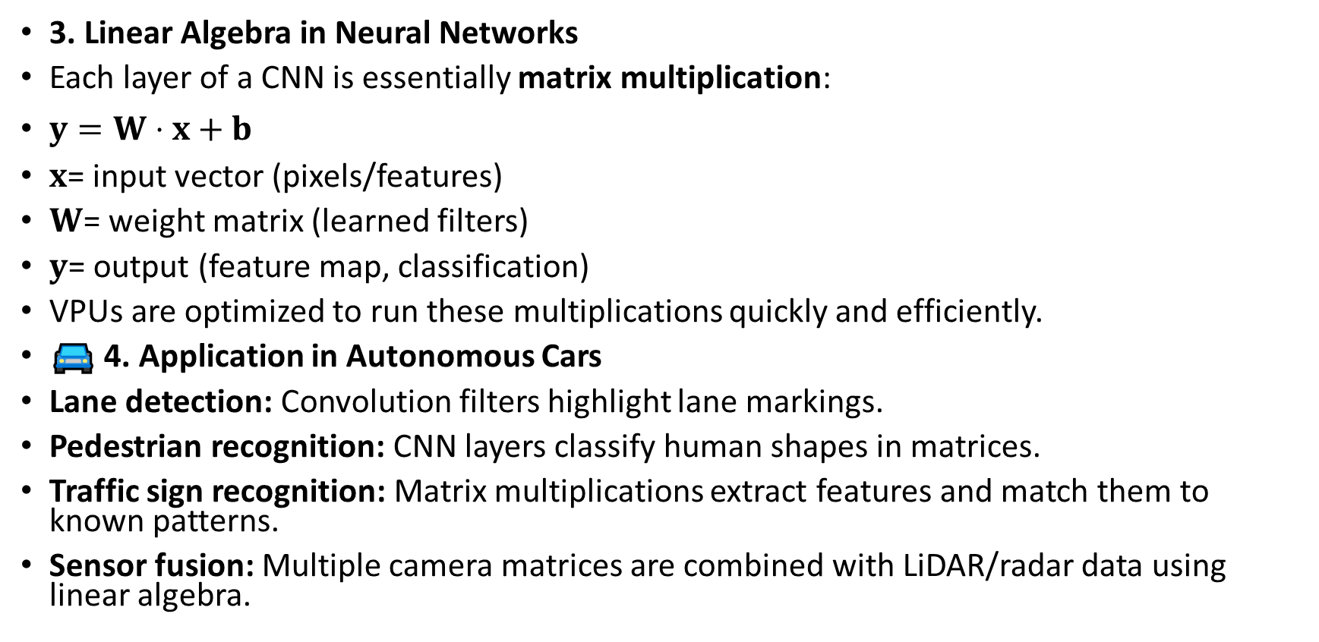
3. Linear Algebra in Neural Networks
Each layer of a CNN is essentially matrix multiplication:
$y=W⋅x+b$
$x$= input vector (pixels/features)
$W$= weight matrix (learned filters)
$y$= output (feature map, classification)
VPUs are optimized to run these multiplications quickly and efficiently.
🚘 4. Application in Autonomous Cars
Lane detection: Convolution filters highlight lane markings.
Pedestrian recognition: CNN layers classify human shapes in matrices.
Traffic sign recognition: Matrix multiplications extract features and match them to known patterns.
Sensor fusion: Multiple camera matrices are combined with LiDAR/radar data using linear algebra.

Slide 13
Why VPUs?
Why VPUs?
GPUs can do this too, but VPUs are specialized:
Lower power consumption.
Optimized for vision workloads (matrix ops on images).
Ideal for embedded automotive systems.
So, every time a self‑driving car’s camera “sees” something, the VPU is crunching matrix multiplications and convolutions to turn raw pixels into meaningful perception — all powered by the linear algebra you’re studying.

Slide 14
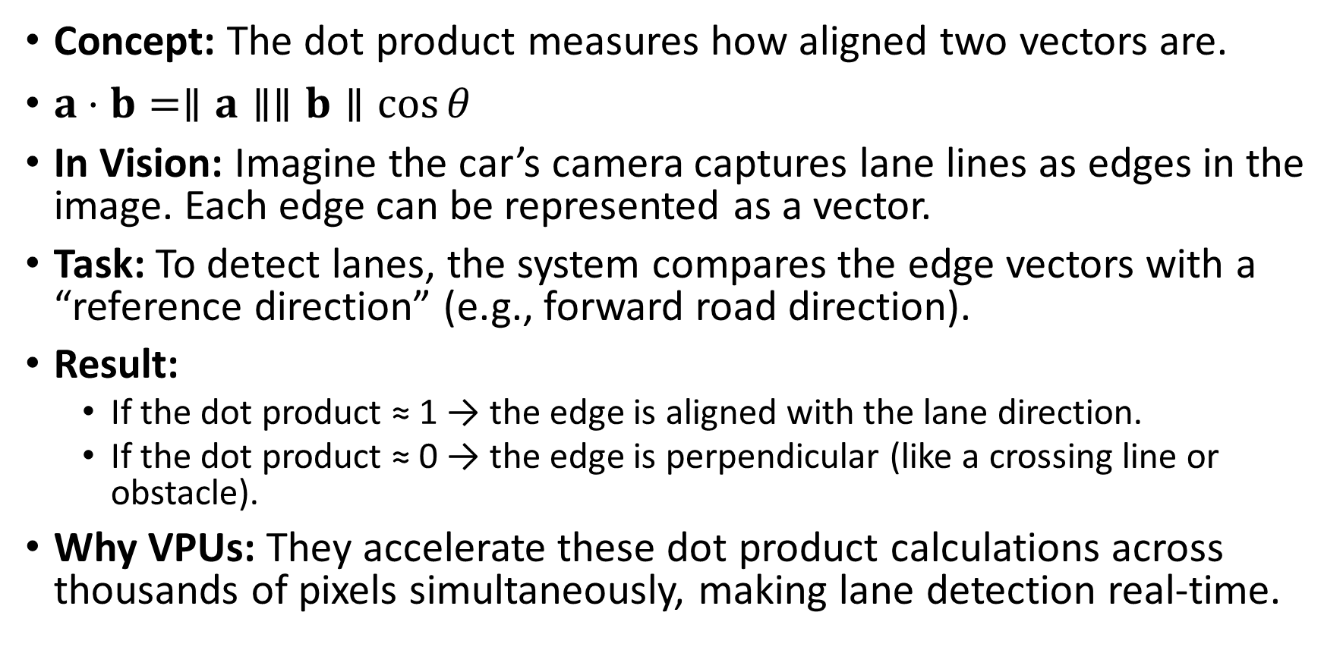
Dot Product → Detecting Lane Markings
Concept: The dot product measures how aligned two vectors are.
$a⋅b=∥a∥∥b∥\cos{θ}$
In Vision: Imagine the car’s camera captures lane lines as edges in the image. Each edge can be represented as a vector.
Task: To detect lanes, the system compares the edge vectors with a “reference direction” (e.g., forward road direction).
Result:
If the dot product ≈ 1 → the edge is aligned with the lane direction.
If the dot product ≈ 0 → the edge is perpendicular (like a crossing line or obstacle).
Why VPUs: They accelerate these dot product calculations across thousands of pixels simultaneously, making lane detection real‑time.

Slide 15
Matrix Transformation → Object Recognition
Matrix Transformation → Object Recognition
Concept: A transformation matrix rotates, scales, or translates vectors.
In Vision: When a pedestrian appears at different angles or scales, the system applies transformation matrices to normalize the image.
Task: VPUs use these transformations so the neural network can recognize “pedestrian” regardless of position, size, or orientation.
Result: Robust recognition even if the person is far away, close up, or partially rotated.
🚘 Why This Matters in Cars
Dot product: Helps align features like lanes, road edges, and vehicle orientation.
Transformations: Normalize objects for consistent recognition.
Together, these linear algebra operations are the mathematical backbone of perception in autonomous driving — and VPUs are specialized to crunch them efficiently.

